Slide 1
Intro to Full Stack Development
Brian Cui | MAD Web "Basic" 2016

Slide 2


What is full stack? Why is it a stack? Is it like pancakes?
"Full Stack" is a broad term that encompasses the layers of software between the browser and the server in web development.
A "Full Stack" developer has language experience in every layer - frontend, backend, middle(end?).
HTML/CSS/JavaScript on the frontend
No(SQL) for database data storage and retrieval
PHP/Python/Perl/JavaScript (thanks, Node) for page generation
Linux/Windows as an Operating System

Slide 3

what is lamp?
LAMP is a common web development "stack".
Linux: The operating system all the software runs on.
Apache: The actual web host responsible for content delivery.
MySQL: The database for storing permanent, relational data.
PHP: The language.
The components of the stack are all used together to create dynamic webpages. The Windows equivalent is WAMP, Mac has MAMP.

Slide 4
Dynamic? but I know javascript
Perhaps you do! But we're talking serverside dynamic.
Your browser can't actually host websites
Content separate from the page has to be stored somewhere and retrieved later
JavaScript can't write to disk (no permanent storage)
You can't store sensitive information in the browser

Slide 5
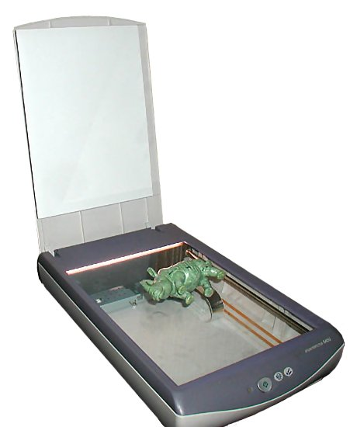
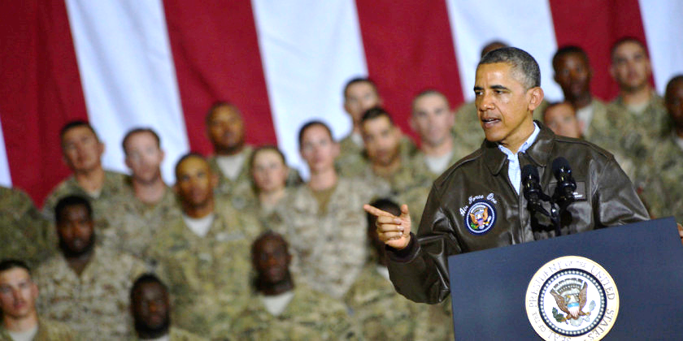
Local File lookup vs. apache
Apache
process
processes
process
index.html
process
process
process
process
content

Slide 6
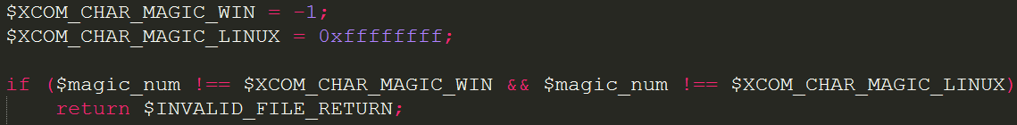
A bit of PHp history
PHP has been around for a long time, since 1995.
It's older than you. With age comes wisdom. Listen to your elders.
The PHP interpreter is written in C
PHP inherits much from C (fopen, fread, fwrite)
Most functions are procedural, i.e. strlen($string) and not $string.length
There's a function for everything
Can anyone guess what nl2br does?
The size of the integer of in PHP is the same as the size of the integer of your machine's C compiler
Notes:
There's a function resize an image, save an image, generate a PDF…

Slide 7
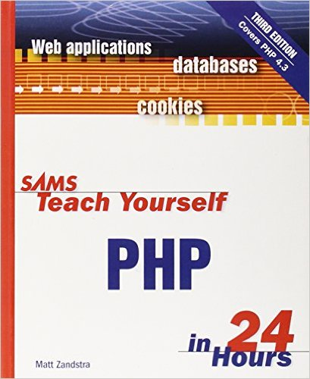
PHP in sixty seconds
PHP really isn't much different JavaScript or other loosely typed languages. Syntax wise, there are a few things you'll need to know:
Everything inside the <?php ?> tags is interpreted, everything outside is output.
PHP is its own "templating language" which we'll see shortly.
Variables must have a $ in front of them, e.g. $my_variable
Arrays aren't Objects, they're primitive types, but behave like JS Objects
Create an ordered array $numbers = array(1, 2, 3);
Create an associative array (dictionary) $properties = array('name' => 'brian', 'age' => 'not old');
String concatenation is performed with .
BRIAN'S
60
SECONDS

Slide 8
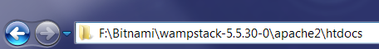
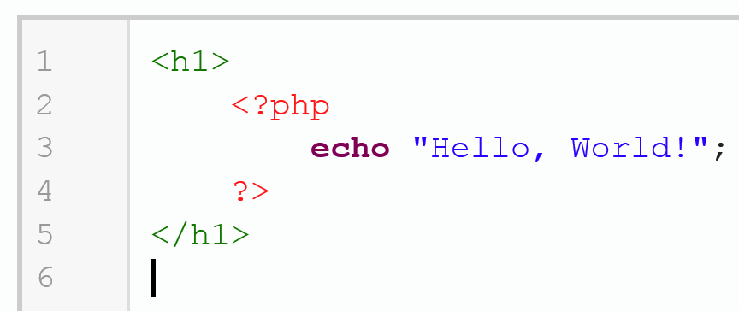
Let's get to work
Find the public root directory of your Apache installation.
It's usually in a folder called htdocs, public, or public_html.
Our friend Apache is responsible for the execution of scripts and delivery of content. Let's begin with…

Slide 9
index? Routing? What?
If we save our PHP in a file called index.php, Apache delivers the file on http://localhost/ in our browser. Why is that?
We'll find that regardless of what we name our file, we can access it from http://localhost/file-name.php
We can make directories, too: http://localhost/myfolder/file-name.php
Routing is the process of "wiring up" URI requests to server-side resources.
The default routing behavior of Apache is to serve files (execute scripts) on the server relative to the public root with the same relative path provided at the end of the URI.
More fancy routing would be like:
https://mail.google.com/mail/u/0/#inbox/15314ed351873d5d

Slide 10
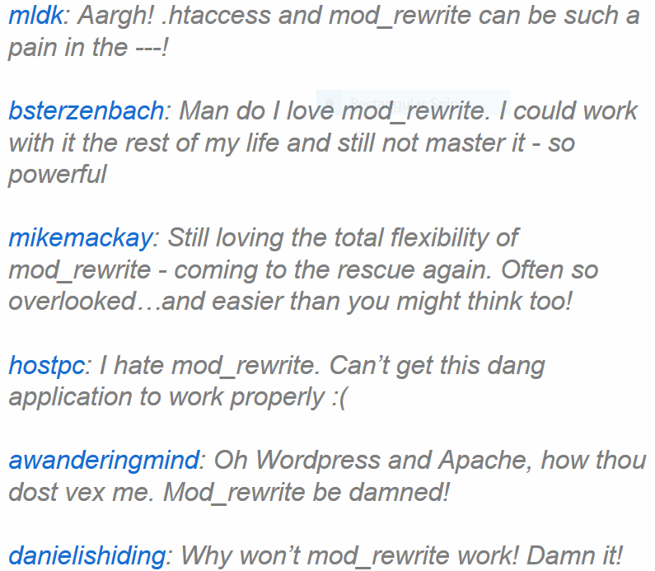
Oh, Apache…
The .htaccess file is a special file that configures how Apache behaves for all requests in the directory (and recursively all children directories).
Here's a snippet I have…
RewriteEngine on RewriteBase / RewriteCond %{THE_REQUEST} ^GET.*index\.php [NC] RewriteRule (.*?)index\.php/*(.*) /$1$2 [R=301,NE,L]
mod_rewrite is the Apache module used for mapping URIs to URLs (routing).

Slide 11
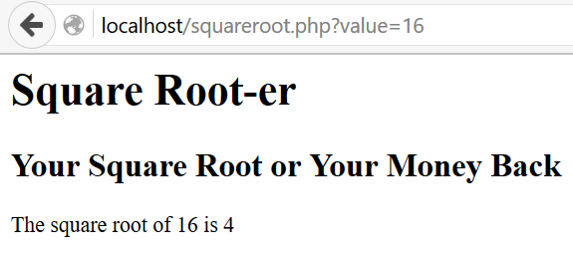
Something more complicated
"That's boring", you say. "I can do that in HTML."
Let's build something a more fancy: a square root calculator using the URL bar.
Request URL format: http://localhost/squareroot.php?value=16
Result:

Slide 12

Get requests, get parameters, get to the chopper
$_GET
?val1=x&val2=y&val3=z
HTTP supports many request types.
The GET request is the default request type, representing information retrieval. The parameters for a GET request are visible in the address bar.
http://localhost/getfun.php?val1=x&val2=y?val3=z
The $_GET superglobal lets PHP access these parameters like an associative array:
$_GET['val1'] === 'x' $_GET['val2'] === 'y' $_GET['val3'] === 'z'
print_r($_GET) Array ( [val1] => x [val2] => y [val3] => z )

Slide 13
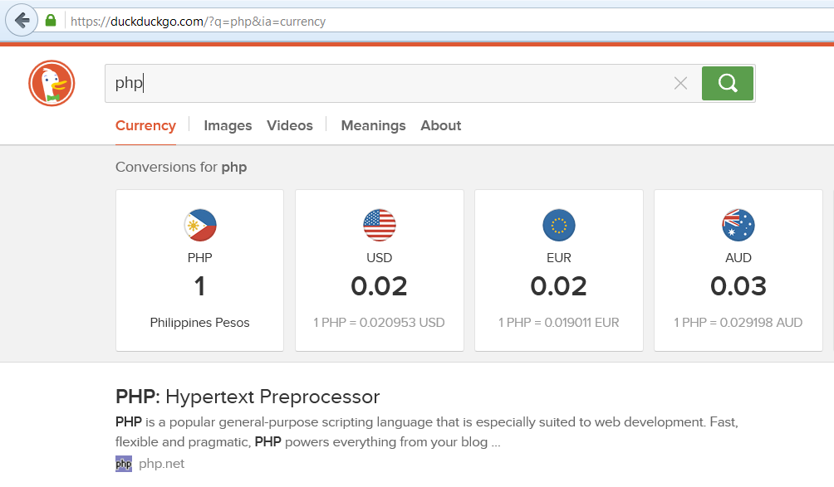
GET with Forms
We can use HTML forms to perform parameterized GET requests! That means, no more manual URL wrangling.

Slide 14
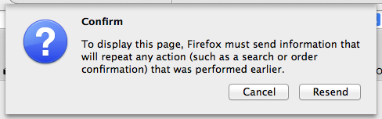
post requests
A POST request represents the creation or consumption of a particular resource.
Unlike GET requests…
POST parameters do not appear in the address bar.
POST requests are not idempotent. Performing a POST request multiple times will result in the same action multiple times, which sometimes is undesirable.
The $_POST superglobal lets us access POST parameters. A simple toggle of our form method from earlier lets us submit requests as POST requests.
<form method="post" action="squareroot-form.php">

Slide 15
Let's build a message board
We've got most of everything we need to start building a persistent web application. Let's build a persistent message board!
Some considerations:
We should design a table for our database
We need to create a user account to access the database
We need to save and retrieve posts from the database
We need a cool, hip, trendy name like Uber

Slide 16
Message board theory
We want to build our message board so that…
There is a list of posts and their authors on the page.
We'll want to query the database for all posts and then print them
There is a form to make a post.
We'll want to submit a POST request somewhere
There is a place to save posts
We'll have to interpret the POST request and execute an insertion query

Slide 17
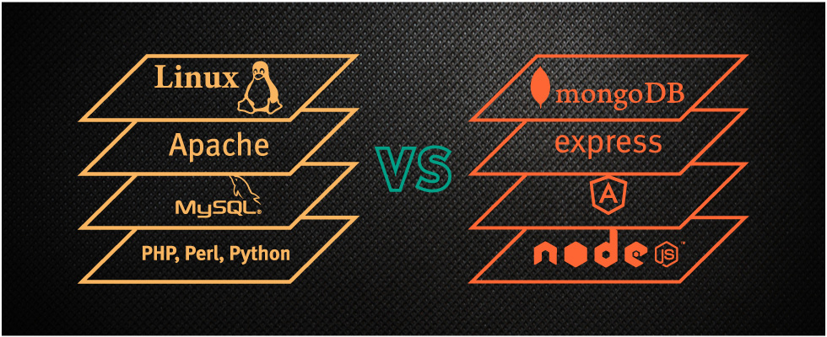
Showdown: Lamp vs mean

